Slide 1
What is the business case for telemetry?

Slide 2
Telemetry Return-On-Investment (ROI) questions
Costs
Possible savings
Enabling telemetry + installing/configuring the Power BI app takes 15-30 minutes (end-to-end)
Telemetry costs is appr. 10 USD per month (can be controlled).
The Power BI app is free, but costs 10 USD per month per user.
How many hours per month will the app save the project wrt status progress reporting?
How many hours per month will the app save the project wrt go-live quality?
How many hours per month will the app save within the support org?
If the answer is 1 hour or more per month, then telemetry has a positive ROI.
Notes:
Costs
Enabling telemetry + installing/configuring the Power BI app takes 15-30 minutes (end-to-end)
Telemetry costs is appr. 10 USD per month (can be controlled).
The Power BI app is free, but costs 10 USD per month per user.
Possible savings
How many hours per month will the app save the project wrt status reports?
How many hours per month will the app save the project wrt go-live quality?
How many hours per month will the app save within the support org?
If the answer is 1 hour or more per month, then I think telemetry+app has a positive ROI and it will be cheaper for the team to onboard than not.

Slide 3
Using telemetry to improve your partner practices and processes

Slide 4
Maturity model*
Pervasive
Strategic
Focused
Tactical
Unaware
Have just enabled
telemetry
Select roles
use telemetry
Projects include
telemetry
Cross-customer (or cross-app) use
Pervasive
Telemetry enables
proactiveness
*inspired by the Gartner BI maturity model

Slide 5
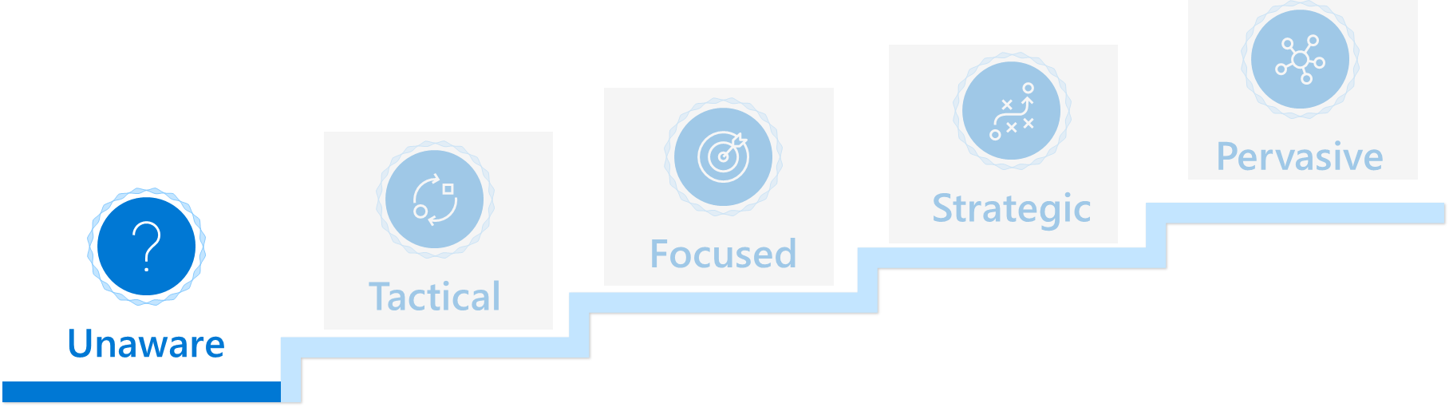
Unaware
Characteristics
Advice
Telemetry is enabled on one or more environments or apps
Partner knows this is important but does not know how to proceed
Help partner get some quick wins
Show insights from the Usage reporting from the Application Insights portal to the business sponsor
Show insights from the Usage report from the Power BI app to the business sponsor
Show insights from the performance Power BI app to the technical sponsor

Slide 6
Usage reporting from the Application Insights portal

Slide 7
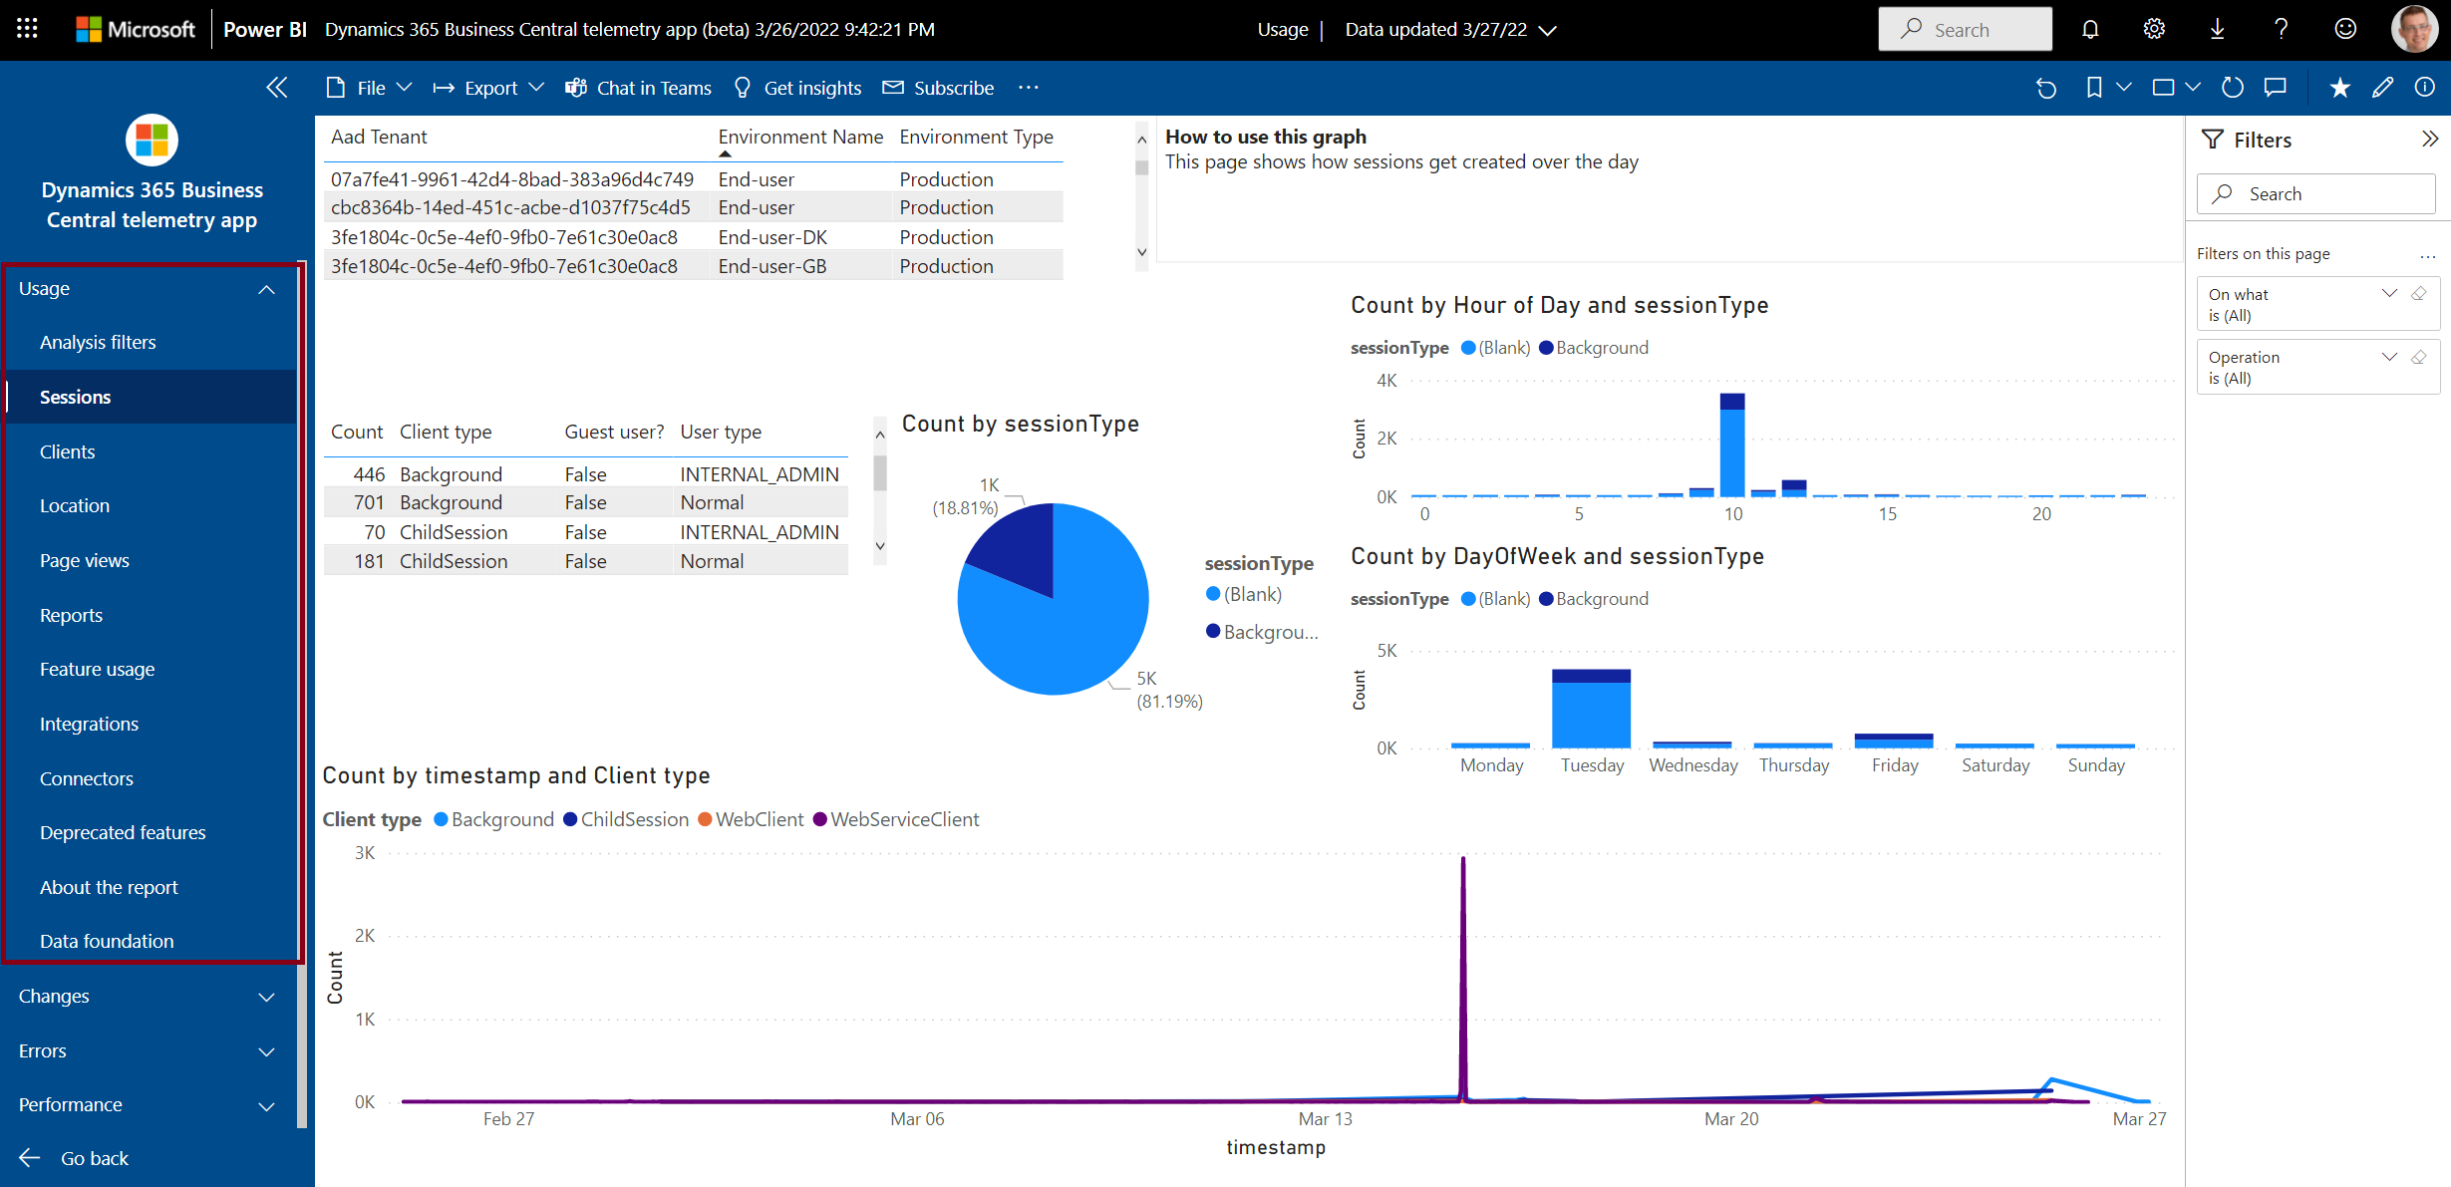
Usage report from the Power BI app

Slide 8
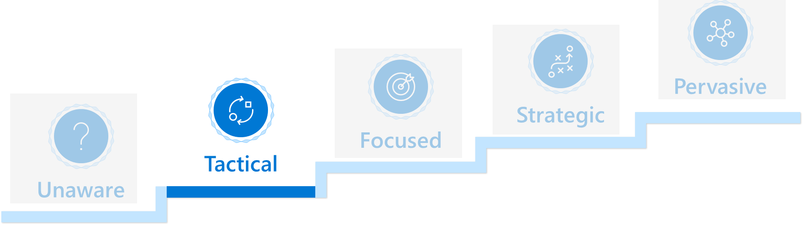
Tactical
Characteristics
Advice
One or more role (typically troubleshooter/support) within the partner org use telemetry
Other roles within partner can see that this benefits roles that use telemetry, but telemetry feels like it is only for the techies
Enhance partners knowledge
Business sponsor must know about
Usage reporting from the Application Insights portal and also the Power BI app
Extension lifecycle signal, both data and shown in the Change report in the Power BI app
Telemetry about reports and pages that customers use
Technical sponsor must know about
The performance report in the Power BI app
The error report in the Power BI
Jupyter notebook TSGs
KQL samples

Slide 9
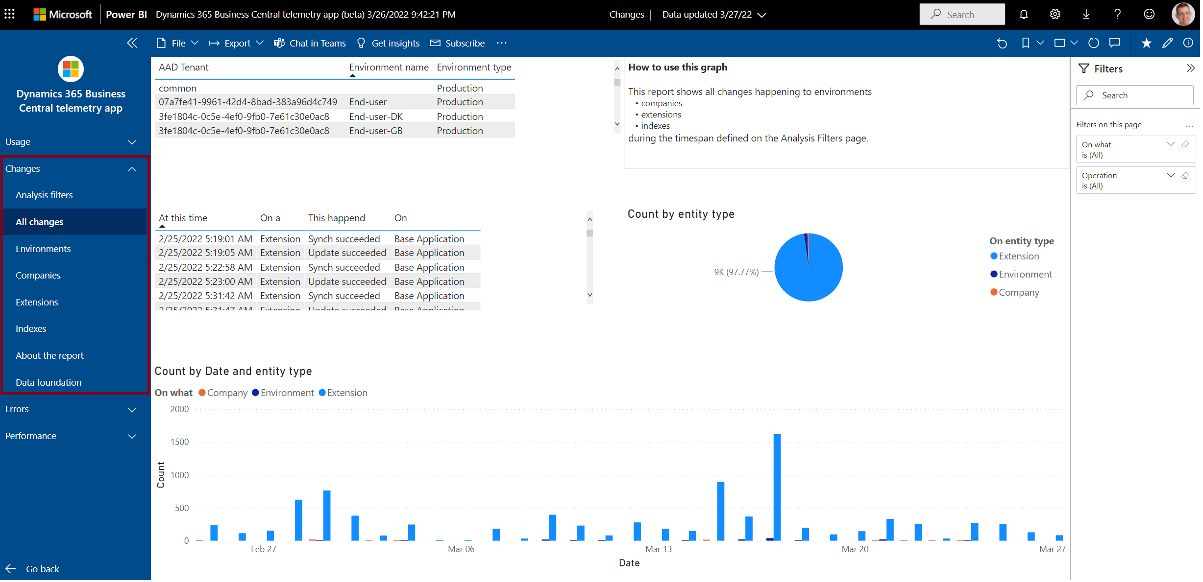
Changes report from the Power BI app

Slide 10
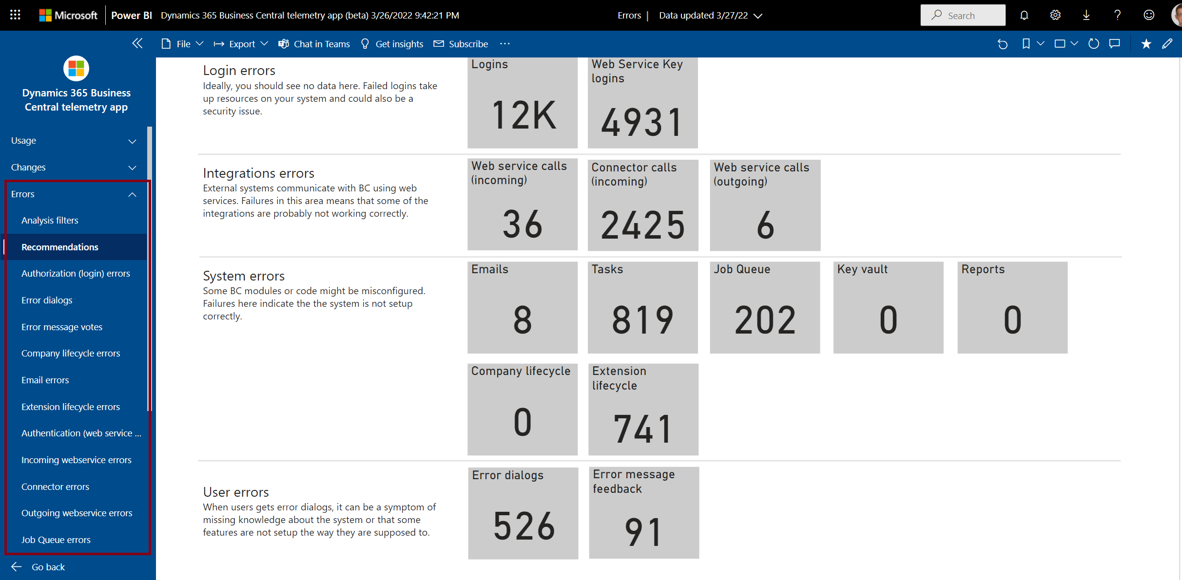
Errors report from the Power BI app

Slide 11
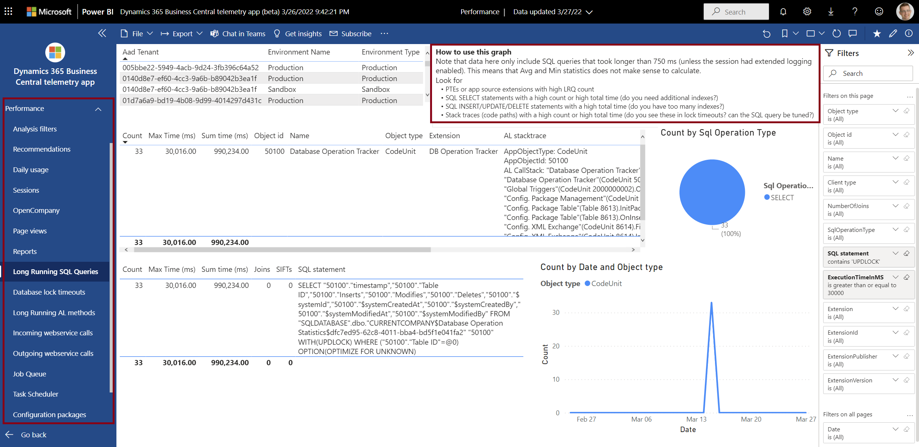
Performance report from the Power BI app

Slide 12
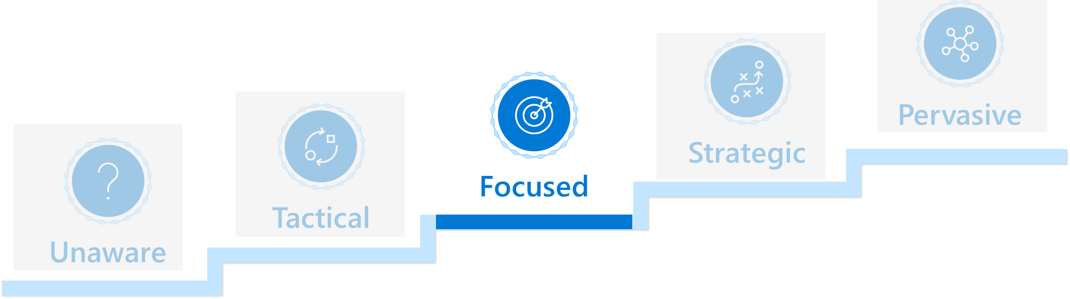
Focused
Characteristics
Advice
Telemetry (and analytics) is being used during implementation projects
Make telemetry investments repeatable and cross-customer
Business sponsor must know about
Funnel reporting from the Application Insights portal (how are users using the product)
Extension lifecycle signal (lifecycle reporting across customers)
Technical sponsor must know about
How to do custom telemetry in extensions
Query telemetry using KQL
How to make your own Power BI reports on telemetry data
How to export telemetry data to a data lake

Slide 13
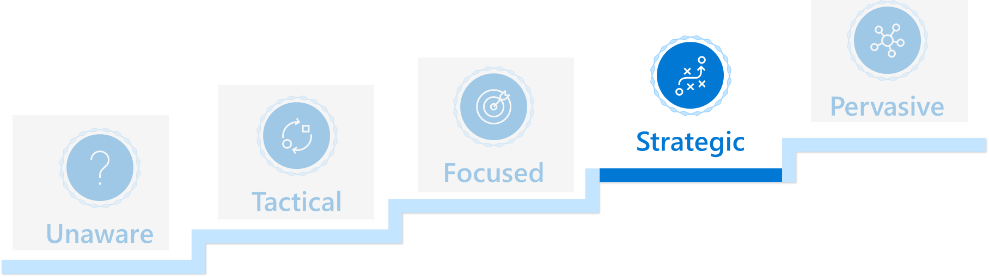
Strategic
Characteristics
Advice
Partner have cross-customer (or cross-app) dashboards that track metrics such as upgrade failure rates, performance regressions, app failure rates
Get from reactive to proactive
Move strategic reporting to use a data lake instead of direct KQL queries
Talk about the difference between tactical and strategic use of telemetry
Learn about alerts and alert channels

Slide 14
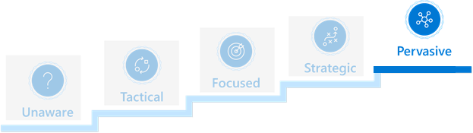
Pervasive
Characteristics
Advice
Partner use telemetry to support most processes
Use the full palette of telemetry tools in all processes
Learn about alerts and alert channels
Share telemetry insights with customers
Challenge if partner use telemetry data for
Sales
Implementation
Maintenance
Follow-ups and post-sales
Feedback loop from telemetry data into partner processes (improve existing processes)

Slide 15
Want to learn more about telemetry?
Documentation: https://aka.ms/bctelemetry
Telemetry FAQ: FAQ.md at microsoft/BCTech (github.com)
Videos: VIDEOS.md at microsoft/BCTech (github.com)
Powerpoint decks: Presentations at microsoft/BCTech (github.com)
Sample code and tips&tricks: https://aka.ms/bctelemetrysamples

